Slide 1
Scaling Project X Across AI POCs
Janani Ramgopal

Slide 2
The Enterprise Reality
Our organisation has over 100 AI POCs built independently across teams. These vary in maturity, technology stack, security posture, and vendor usage. Integrating them directly into Project X would introduce risk, inconsistency, and governance gaps.

Slide 3
PROBLEM
Different vendors & tech stacks
Fragmented AI ecosystem with heterogeneous technologies and vendors.
No central visibility
Lack of a single source of truth for AI capabilities across the organisation.
Inconsistent security standards
Uncontrolled vendor usage leading to unpredictable AI spend.
Cost unpredictability
Loss of productivity costing consumers thousands of dollars
No maturity classification
No objective framework to assess production readiness or risk posture.

Slide 4
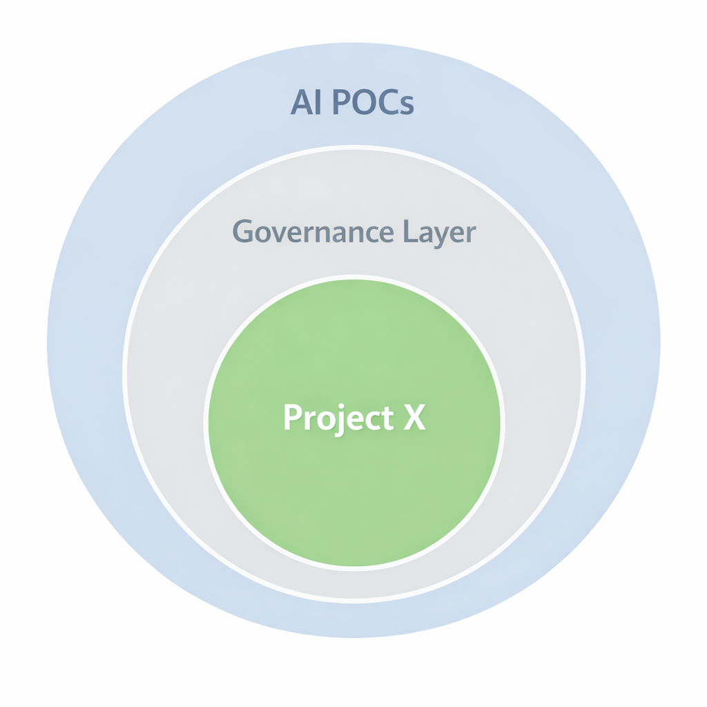
Standardize Integration, Not Innovation
Introduce a centralized AI Governance Layer
Purpose:
• Registration
• Validation
• Maturity classification
• Enforcement

Slide 5
Governance Layer Capabilities
Model Registry
A centralized catalogue of all AI models with ownership, risk, and metadata transparency.
Maturity Scoring
Objective, criteria-based assessment of AI readiness and operational stability.
Policy Validation
Automated rule enforcement to ensure compliance before model integration.
Runtime Enforcement
Real-time control over model access, usage conditions, and invocation eligibility.
Audit & Visibility
End-to-end traceability of AI usage, decisions, and governance actions.

Slide 6
Maturity Tier Model
Maturity is not self-declared. It is calculated objectively based on governance criteria. Project X can define minimum tier requirements.
Tier | Meaning
0 | Experimental
1 | POC
2 | Controlled
3 | Production Ready
4 | Enterprise Critical
Maturity is calculated based on :
Security review
Logging
SLA
Risk assessment
Monitoring

Slide 7
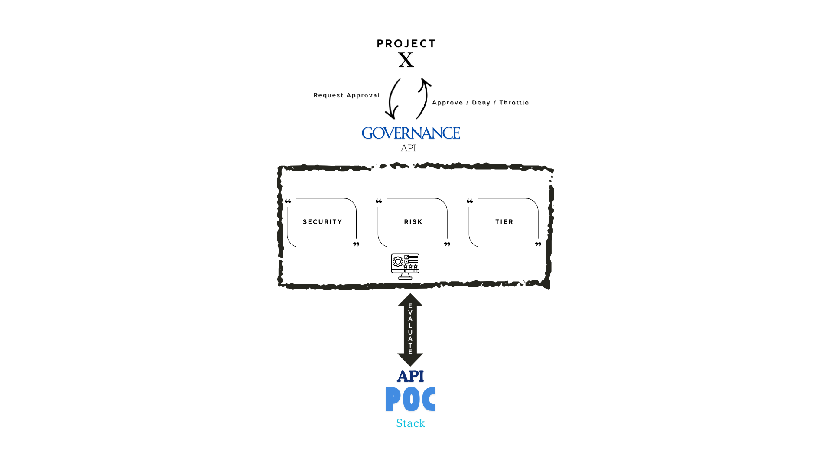
Runtime Enforcement Flow

Slide 8
evolution into
AI Control PlanE
Traffic control
Dynamic regulation of model invocation rates to manage load and risk exposure.
Cost governance
Continuous monitoring and control of AI spend across vendors and use cases.
Vendor risk monitoring
Centralized oversight of third-party AI dependencies and contractual exposure.
Real-time revocation
Immediate suspension of model access in response to security, compliance, or performance concerns.
Central AI observability
Unified visibility into AI performance, risk posture, and operational health across the enterprise.

Slide 9
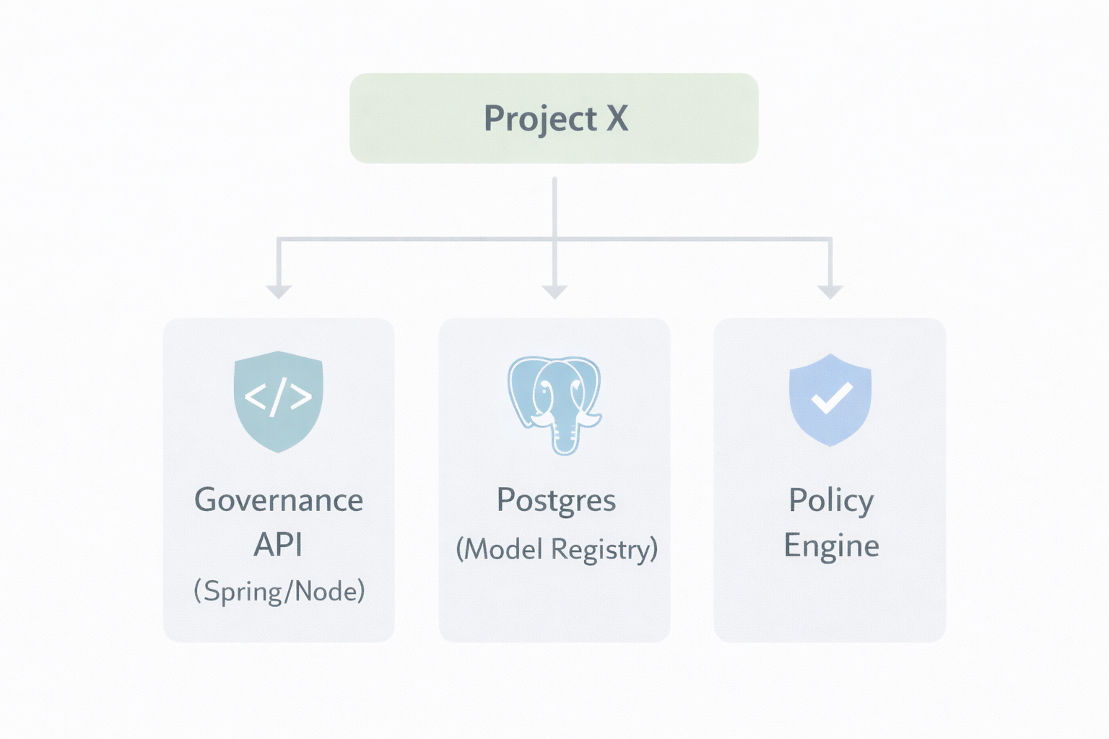
MVP Architecture (What I Would Build First)
MVP Scope:
• Model Registration API
• Tier Calculation Engine
• Validation Endpoint
• Basic Dashboard

Slide 10
Enterprise Benefits
Safe scaling of AI innovation
Transparent maturity model
• Enables federated experimentation without compromising enterprise controls
• Provides a structured path from POC to production
• Supports rapid onboarding of new AI capabilities with guardrails
• Provides objective, criteria-based readiness scoring
• Eliminates ambiguity in production deployment decisions
• Encourages continuous improvement toward higher tiers
Reduced integration risk
Cost governance
• Enforces validation before production invocation
• Prevents low-maturity or non-compliant models from exposure
• Decouples Project X from heterogeneous AI implementations
• Tracks vendor usage and consumption patterns centrally
• Enables proactive cost threshold monitoring and alerts
• Prevents uncontrolled AI spend across teams
Security standardization
Executive visibility
• Ensures consistent logging, SLA, and review requirements
• Applies uniform policy enforcement across all AI integrations
• Reduces exposure to PII and regulatory violations
• Centralized dashboard of AI portfolio health
• Clear mapping of risk, spend, and vendor exposure
• Data-driven oversight of AI adoption strategy

Slide 11
Summary
Rather than controlling how teams innovate, I would control how innovation integrates into the enterprise. This design creates a structured pathway from experimentation to production, transforming fragmented AI initiatives into a governed, scalable capability aligned with business strategy.
Future Enhancements:
• Drift detection
• AI security red-teaming
• Bias monitoring
• Automated promotion workflows

